Slide 1

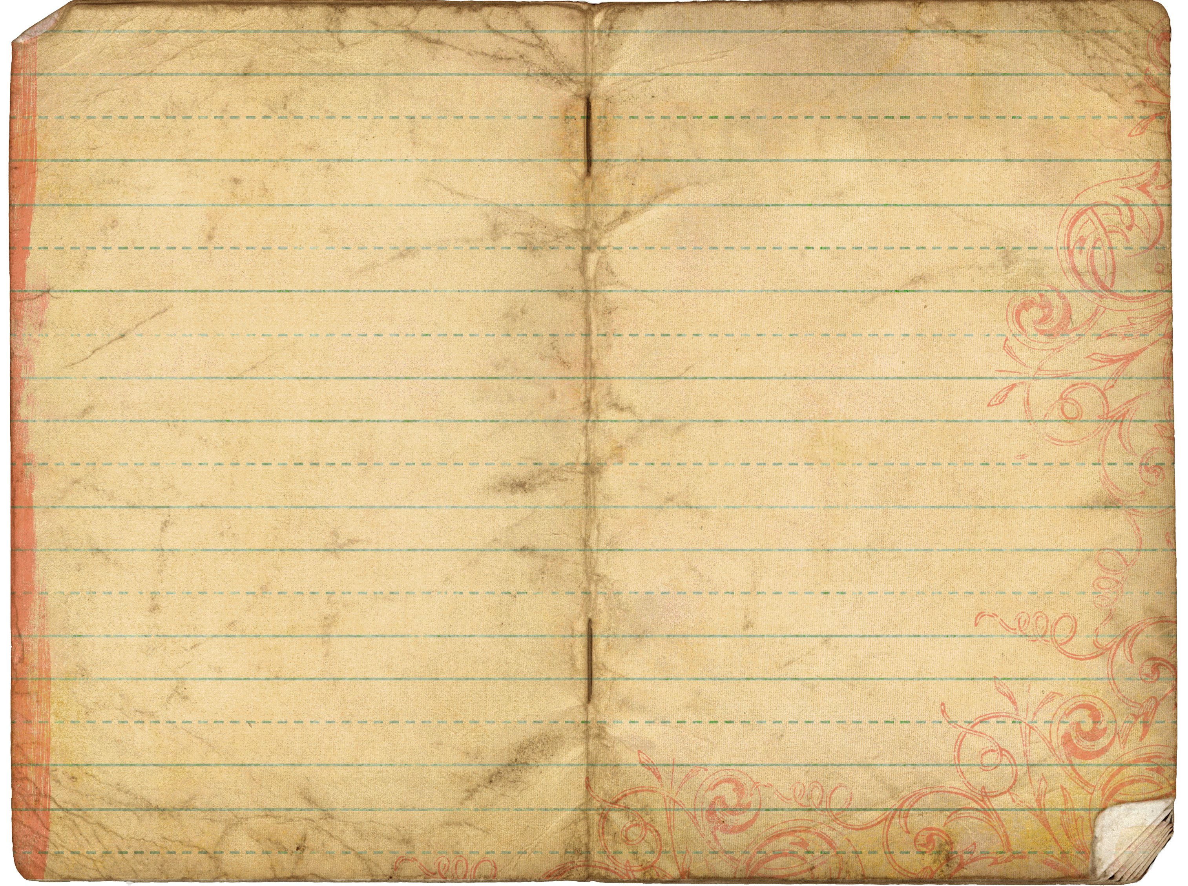
History
The Trek began in my college years as I began to try to come to grips with my past - and my present. I was dealing with the emotions of years of abuse and the struggles I kept having with failed relationships with both family and friends. It was not a "happy" time for me as I began to search for some way of moving forward.
As I began to heal, I had the opportunity to work with teenagers through a nonprofit organization. I was handed a group of boys and told to "teach them something". I dug out my notes from my college years and, on my vacation, wrote "Self-Image". Because of their positive reaction and request for more, I spent much of my personal time in the next year writing follow-up classes. Then, when I left the organization, I took all of my notes and put them away.
In 2011, I was given the opportunity to present a break-out session at a seminar. I began to search through my notes and found the outline I had written - but never completed - for "Forgiveness". I spent a weekend creating the first class in what my wife called “The Trek”.
When people told me how much they connected to the class, I decided to bring out the rest of the material, update it and see if it would change the lives of others as it did mine so long ago. The Trek is based on input, feedback and many personal stories from many coworkers and friends; along with a lot of advice and assistance from my wife, Maria. My thanks go out to all of you who have shared your lives to help others!
All of us at The Trek wish you all the best on your own journey!
The Trek
What Is The Trek?
Home
Programs
History
Get Started…
Contact Us

